Slide 1
7-segment LED1
seg_led1[6..0]
Seg_led1_en
I/O Board
DIP input switches
io_swt_a[7..0]
DIP1 = io_swt_a(0)
DIP2 = io_swt_a(1)
…
DIP8 = io_swt_a(7)
io_swt_c
io_swt_b
io_swt_a

Slide 2
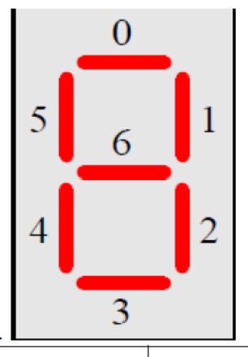
iCE40 FPGA
top_bcd_display.
vhd
Led[7..0]
LED outputs
FPGA board
I/O board
DIP Switch A
io_swt_a[7..0]
seg_led_out[6..0]
seg_led1_en

Slide 3
top_bcd_display.vhd
I/O board
DIP Switch A
io_swt_a[0..7]
pulldown.vhd
seven_seg_display.vhd
clk_in
seg_led_out[6..0]
pd_swa_out
(3..0)
‘0’ = GND
seg_led1_en

